Slide 1
Part B
Human numbers linked to
Environmental Degradation
via the Economy

Slide 2
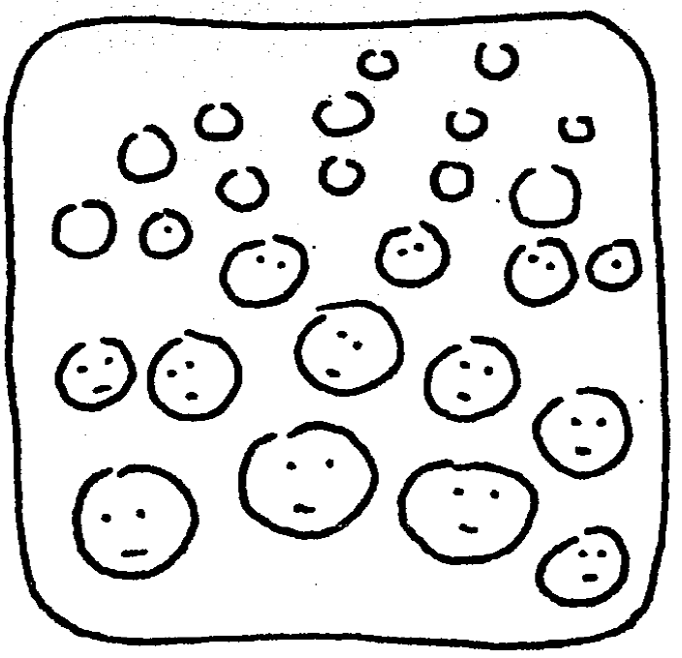
Are there more people on Earth than is helpful for the planet? Most probably ‘Yes’ …

Slide 3
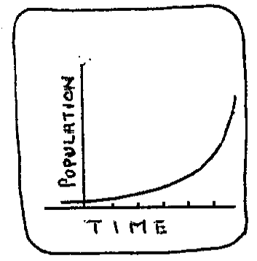
World population is increasing

Slide 4
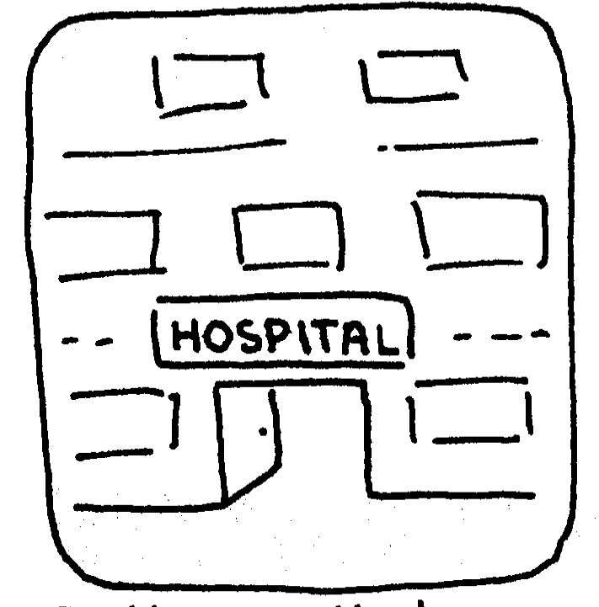
Better medical care means that people now live longer

Slide 5
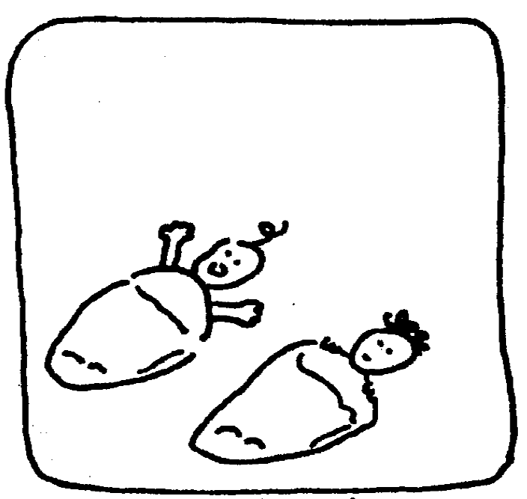
Babies which once might have died as infants …

Slide 6
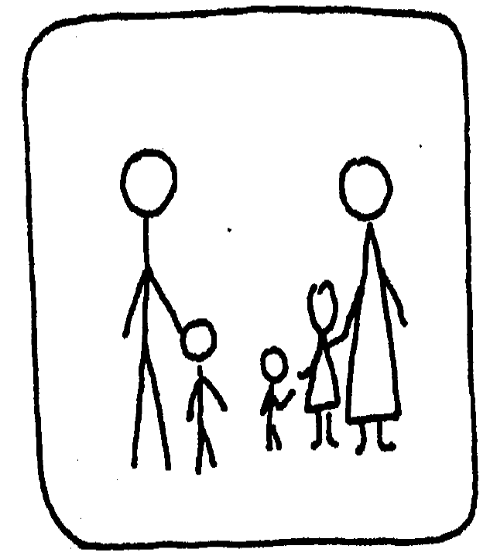
…now live to produce families of their own.

Slide 7
Each living person has ‘needs’ which the Earth must supply …

Slide 8
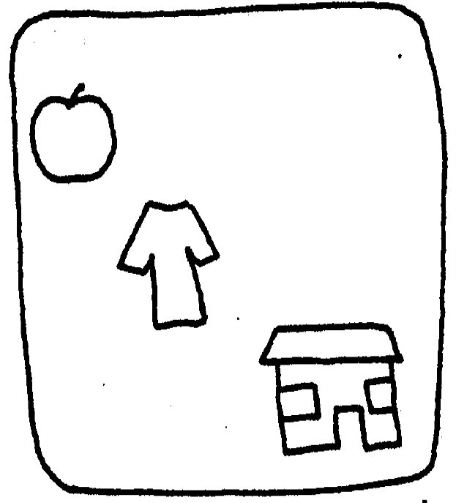
FOOD, CLOTHING, SHELTER and ENERGY SUPPLIES are the basic needs.

Slide 9
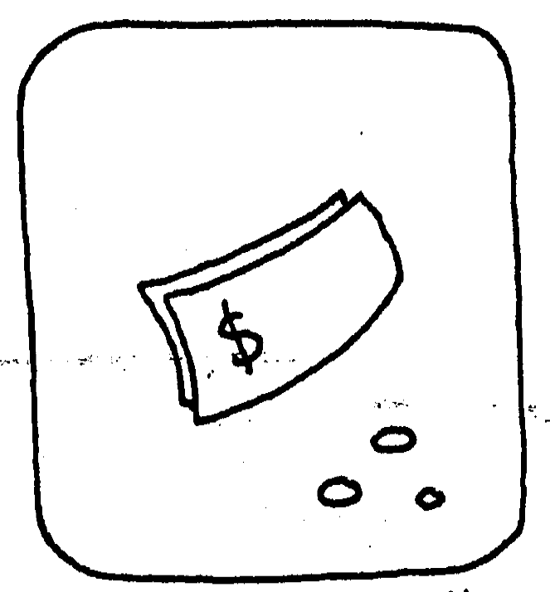
Money is usually the key to these things.

Slide 10
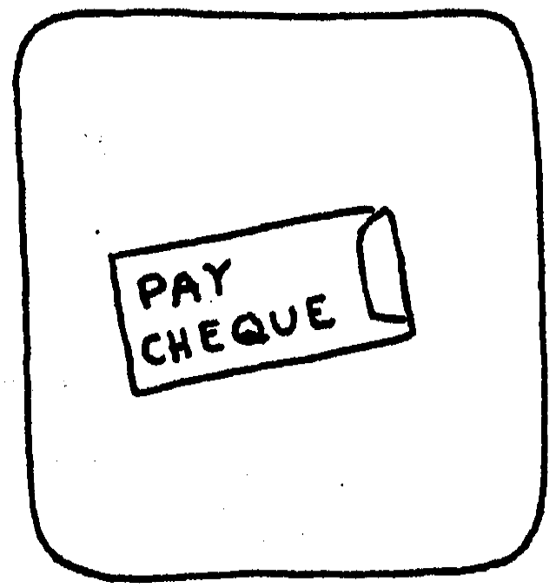
But where does the money come from?

Slide 11
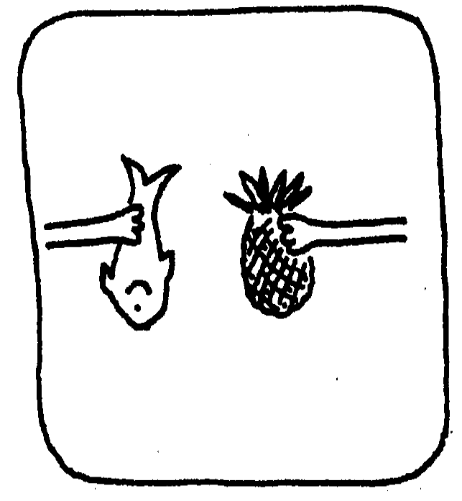
Trade existed before there was money

Slide 12
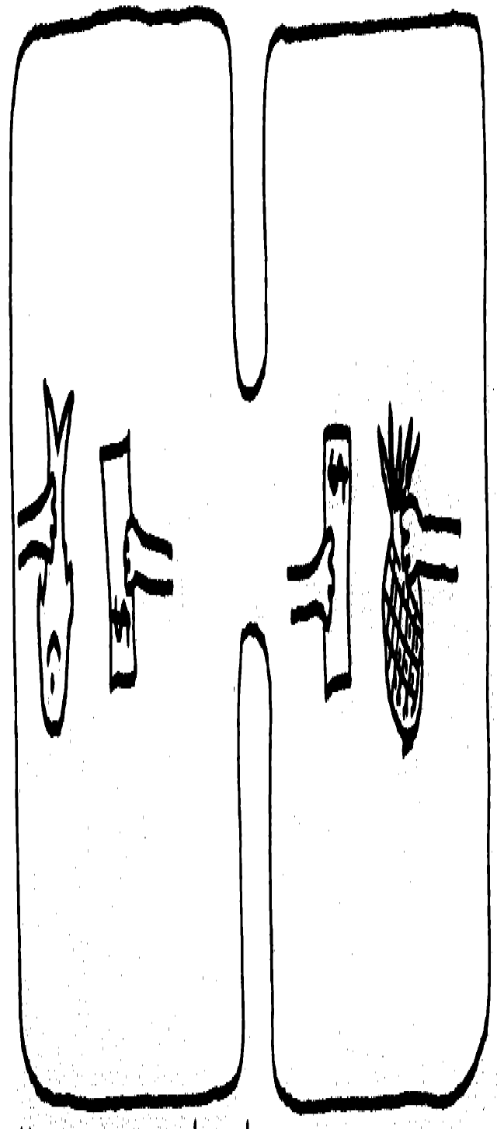
Money was developed as a convenient way of selling …
… and buying things

Slide 13
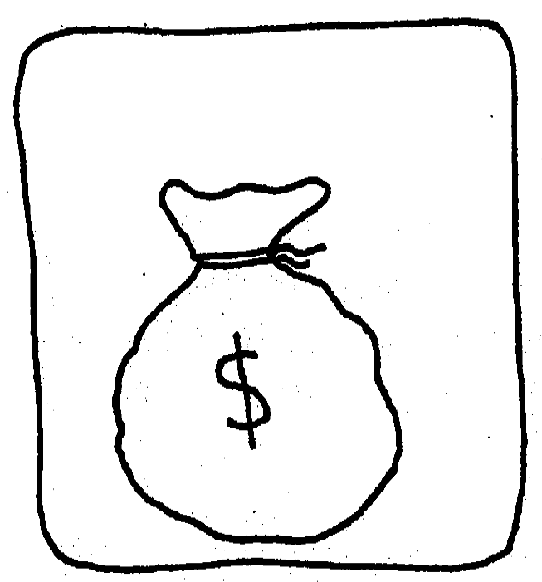
But money by itself is useless …

Slide 14
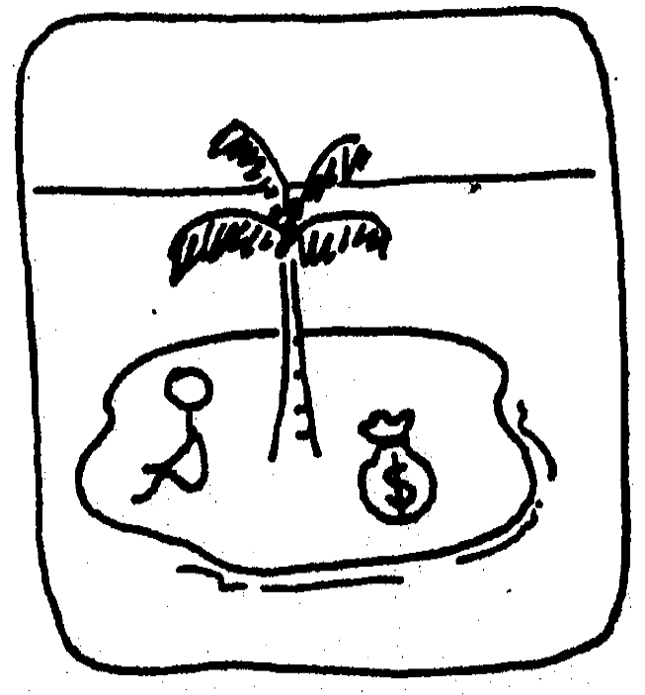
… without things to spend it on.

Slide 15
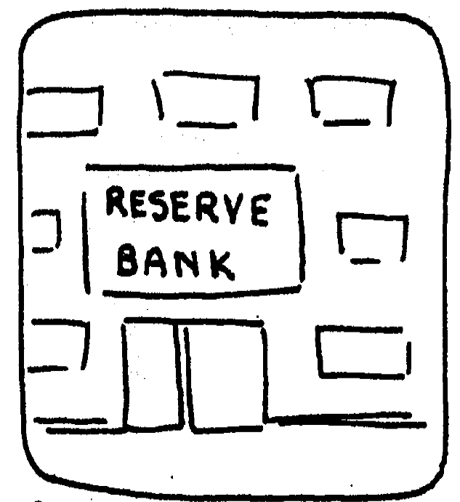
And money cannot be circulated unless it is backed by …

Slide 16
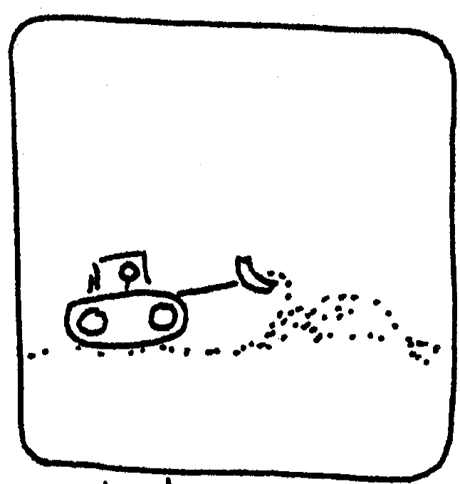
production from the ground e.g. mining

Slide 17
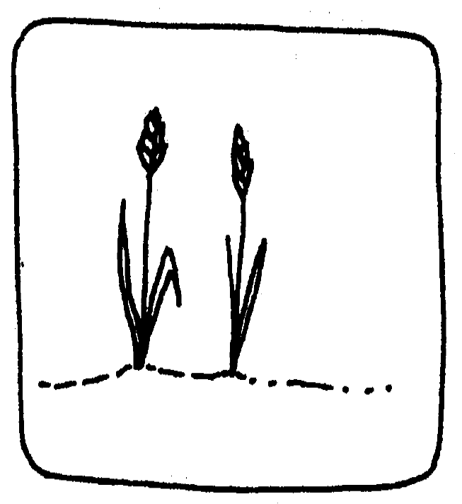
or from the soil, e.g. agriculture

Slide 18
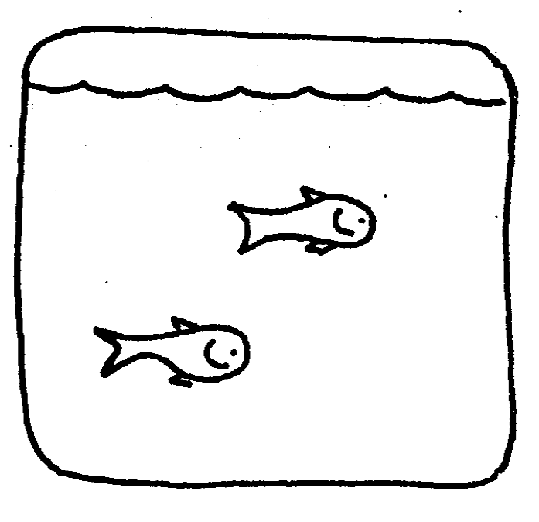
or from the sea, e.g. fishing

Slide 19
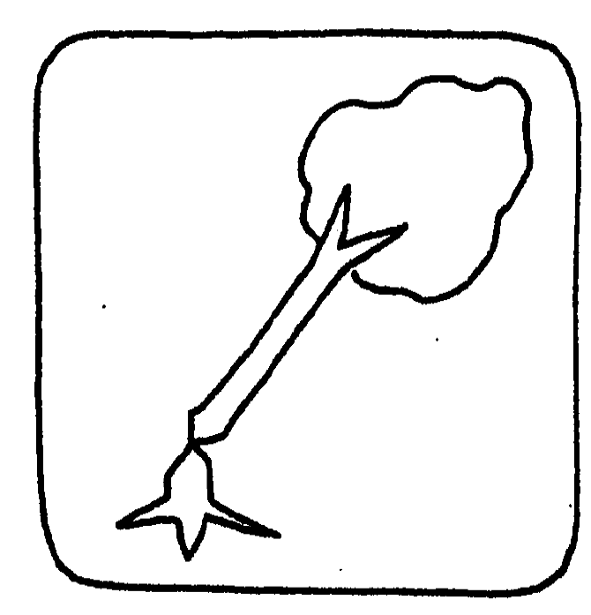
or from the bush, e.g. forestry

Slide 20
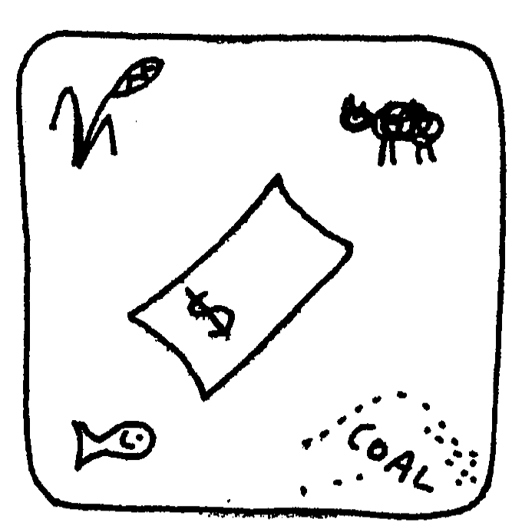
So, money has to be backed by production.

Slide 21
Think about where your money comes from …

Slide 22
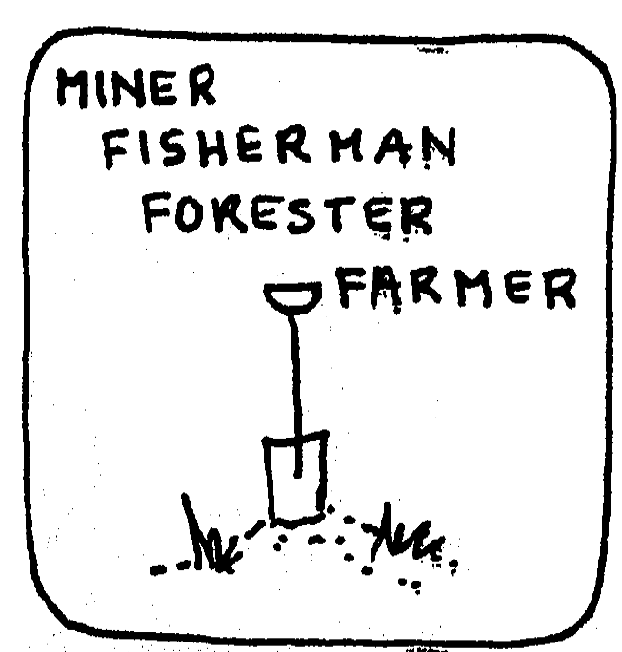
Some people have jobs which are directly related to the Earth’s provision.

Slide 23
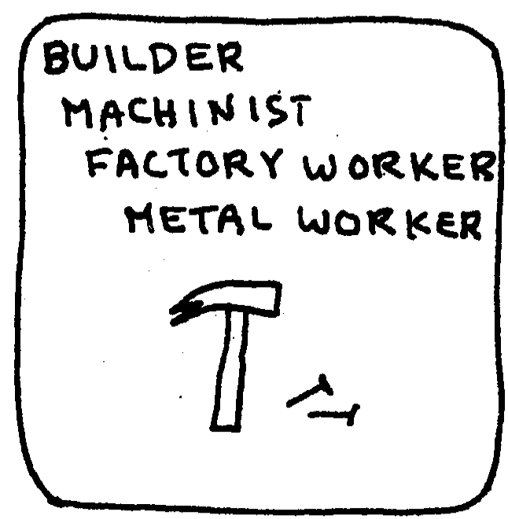
The jobs of others depend on the raw materials which the Earth supplies.

Slide 24
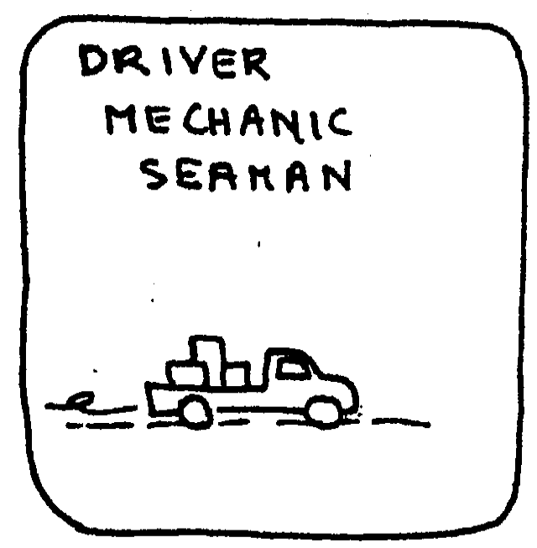
Still more people have work in the service industries related to goods produced from the Earth.

Slide 25
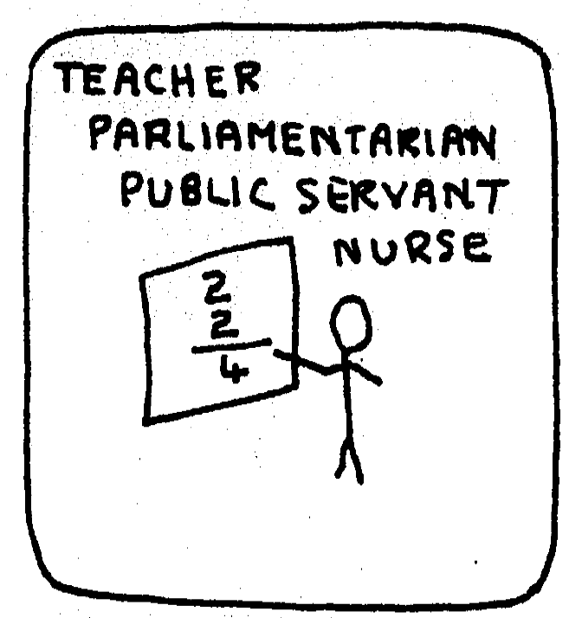
Some people’s salaries come from the taxes which are paid by others.

Slide 26
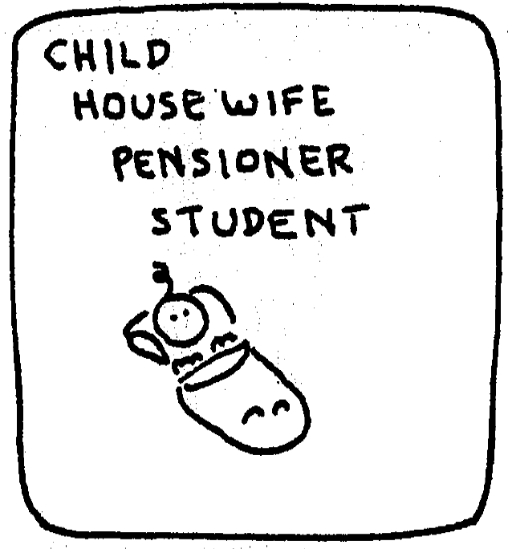
Some people depend on the work of others for their financial support.

Slide 27
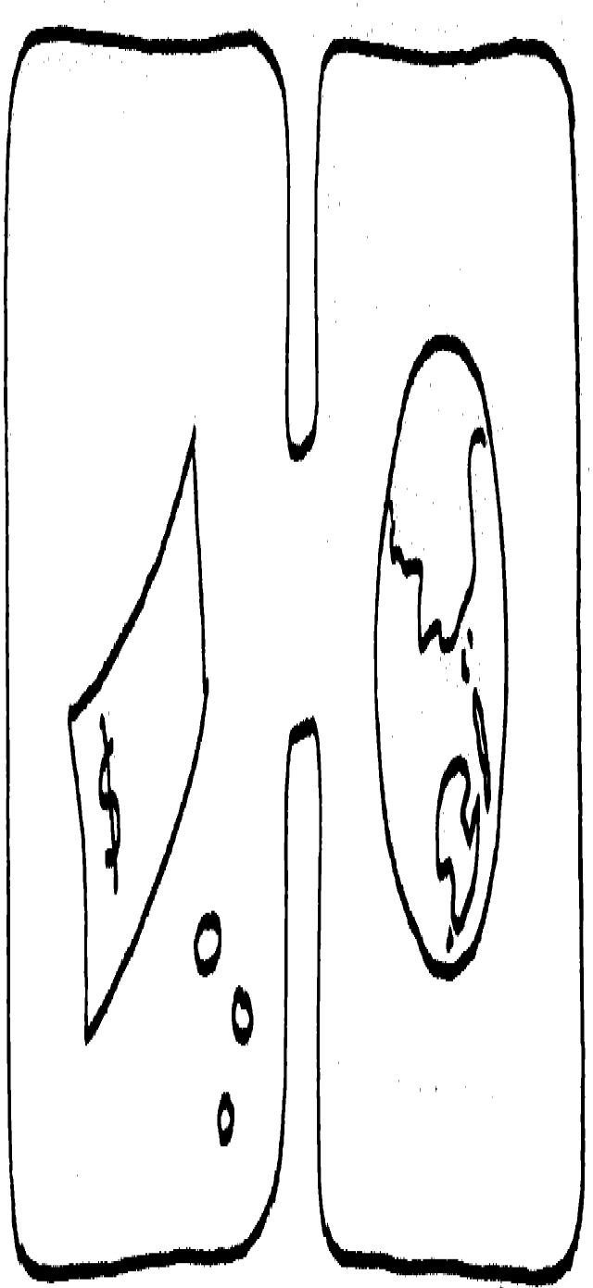
When we trace our money back to where it came from originally
… we will find it is from the productivity of the Earth.

Slide 28
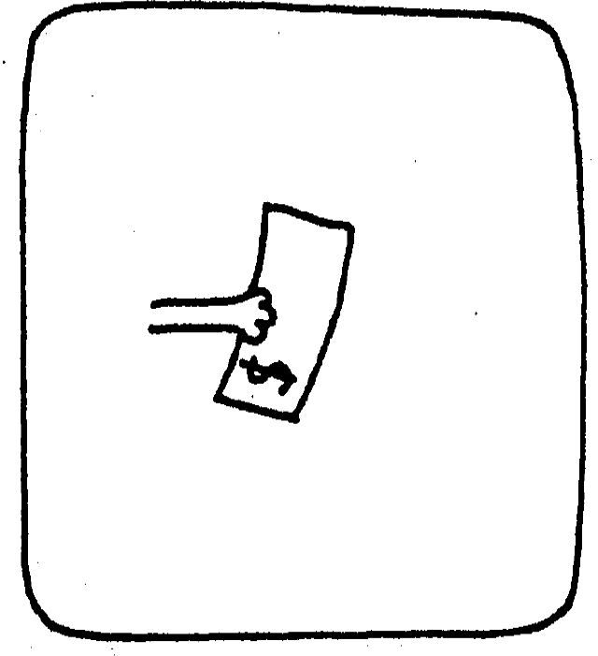
And what will we exchange it for?

Slide 29
We will spend it on GOODS and SERVICES …

Slide 30
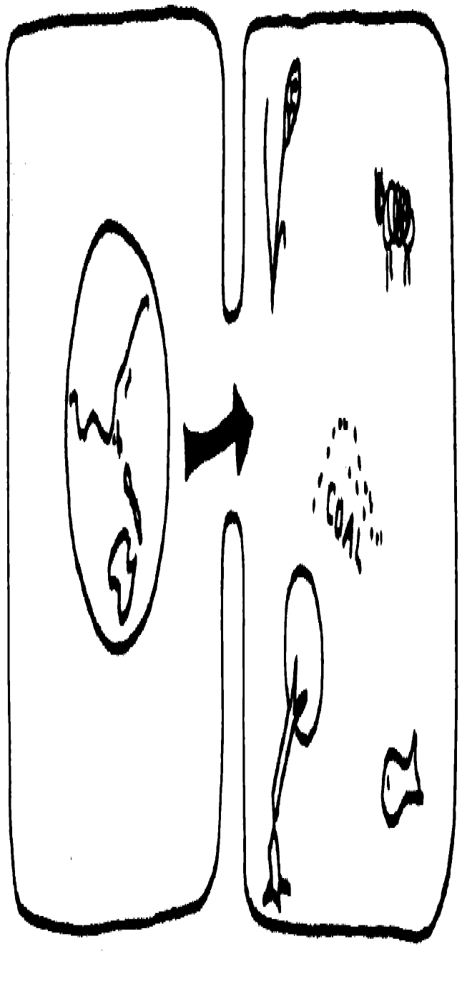
… all of which flow from the productivity of the Earth.

Slide 31
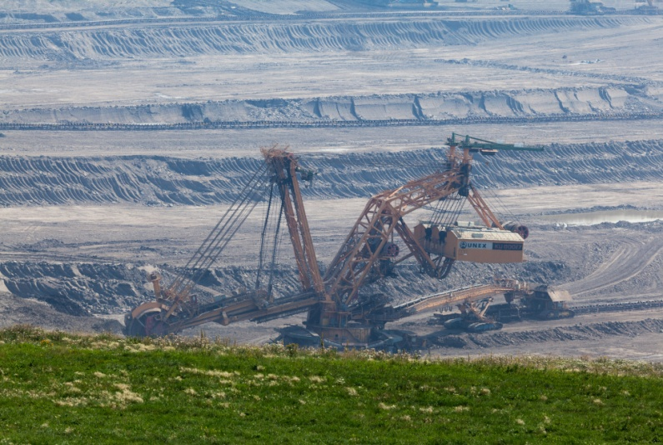
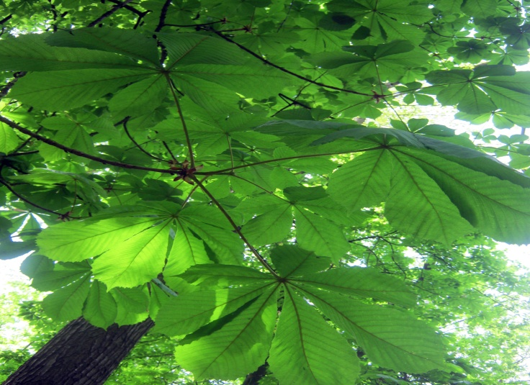
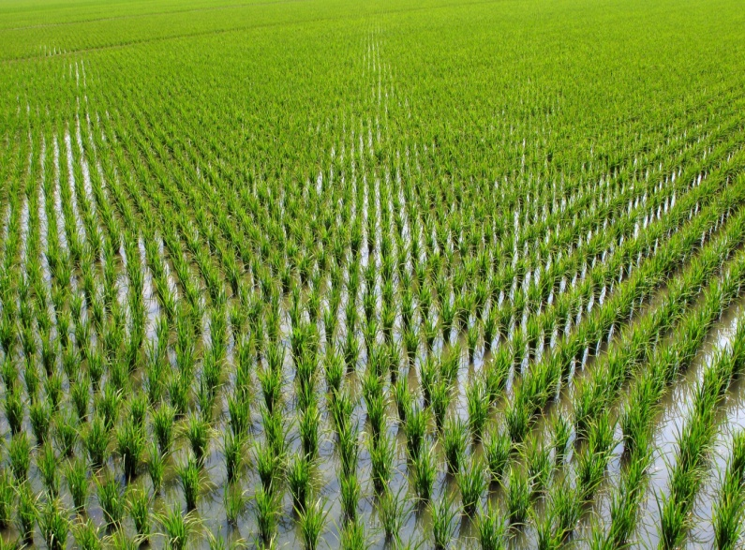
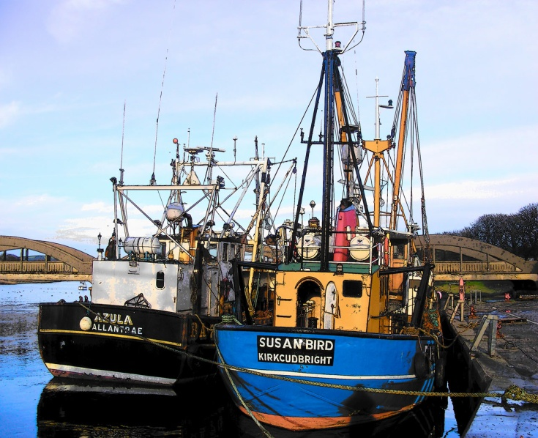
Mining
Forestry
$
Agriculture
Fisheries

Slide 32
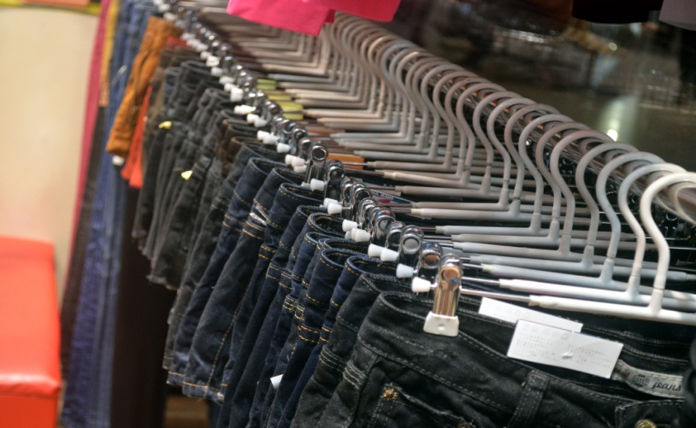
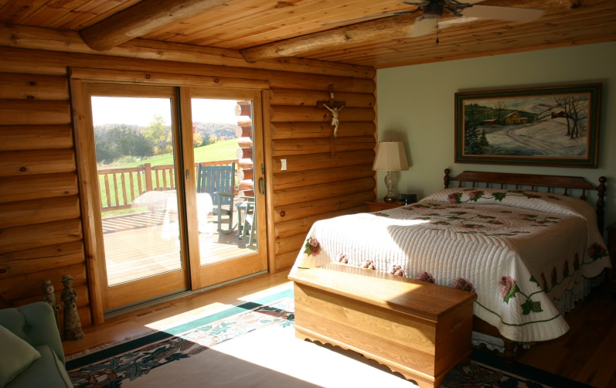
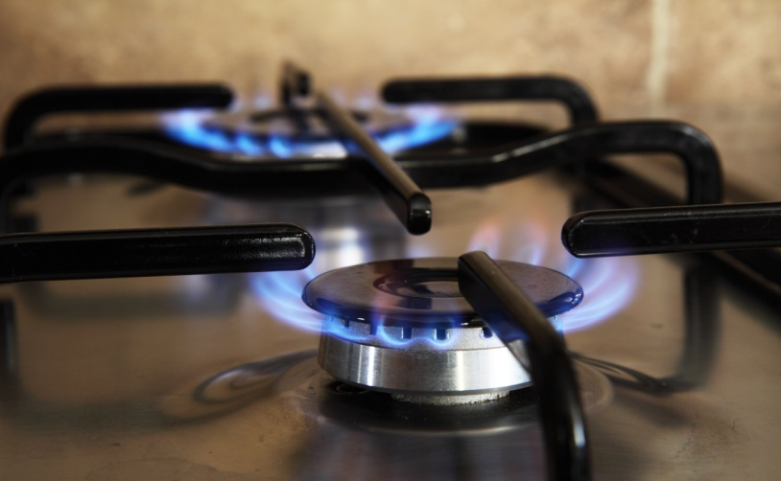
Food
Clothing
$
Shelter
Energy supplies

Slide 33
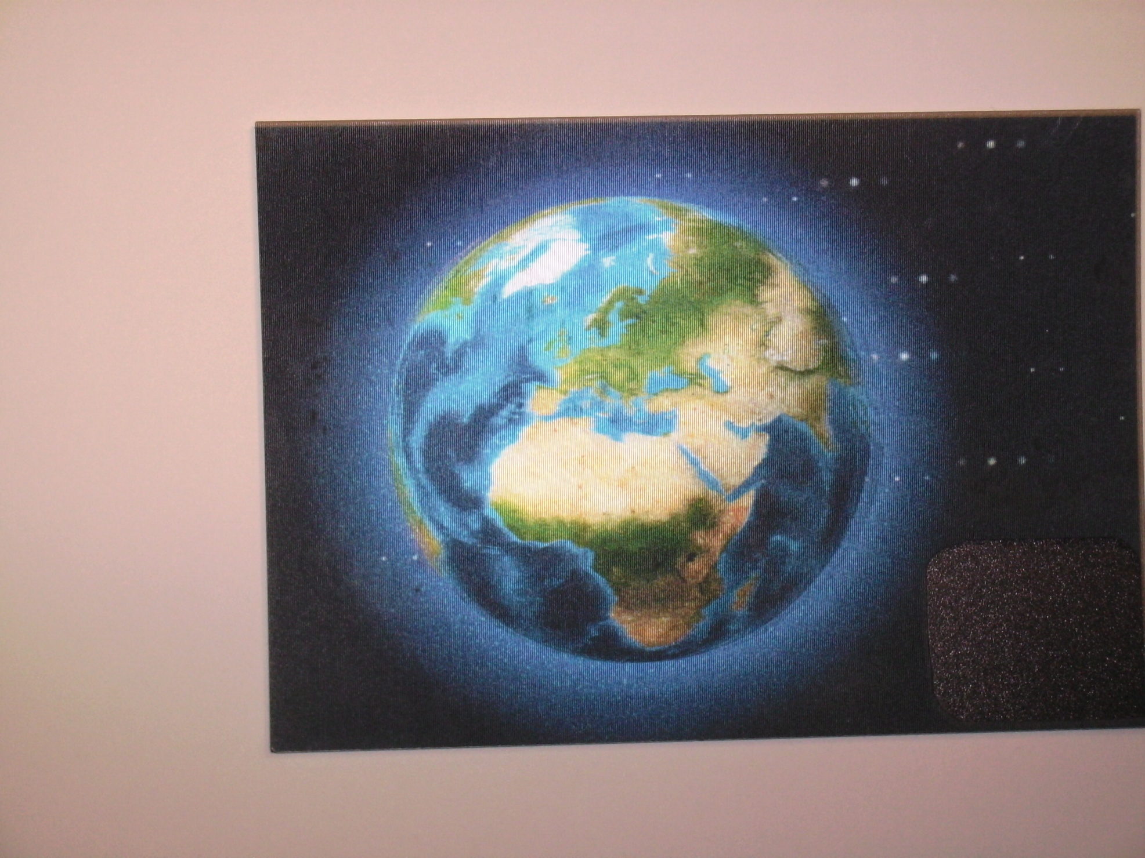
In 1986 we began to overshoot Earth’s renewable resources, just before we reached 5 billion people.
We are now using forests, fish, topsoil etc., faster than they can be renewed. We need 1.5 ‘earths.’

Slide 34
EARTH OVERSHOOT DAY - Getting earlier
Date by which biocapacity used up Weeks to use up
31st Dec 1986
19th Dec 1987
7th Dec 1990
21st Nov 1995
1st Nov 2000
20th Oct 2005
26th Oct 2007
23rd Sep 2008
25th Sep 2009
21st Aug 2010
27th Sep 2011
22nd Aug 2012
20th Aug 2013
52
50
48.5
46
43.5
42
43
38
38
34
38.5
33.5
33
- Global Footprint Network

Slide 35
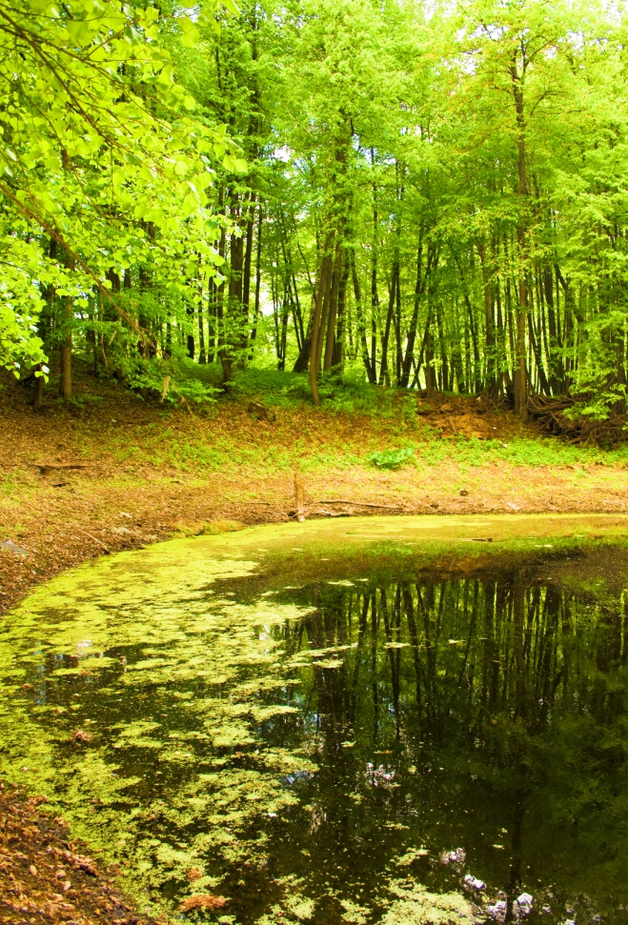
(1) Ecosystems
Overall, any clear dichotomy between pristine ecosystems and altered areas that may have existed in the past has vanished
Main Causes:
(1) Increase in atmospheric CO₂
(2) Increase in fixation of N₂ for fertilisers
(3) Human land use … has transformed 1/3 to 1/2 of Earth's ice-free surface.
These three and other equally certain components of global environmental change are the primary causes … of ongoing losses of biological diversity. They are caused in turn by the extraordinary growth in size and resource use of the human population. - Peter M. Vitousek

Slide 36
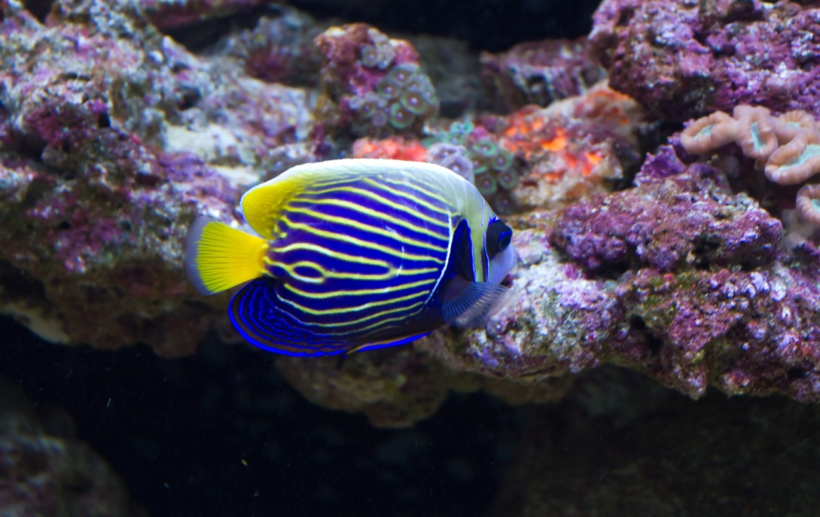
(2) Species
“Climate change is a threat (to species) because species have evolved to live within certain temperature ranges … when these are exceeded and a species cannot adapt (in time)
Surgeon Fish
.. or when the other species it depends on to live cannot adapt…”
“Climate change alone is expected to threaten with extinction approximately one quarter or more of all species on land by the year 2050 … Species in the oceans and in fresh water are also at great risk … especially those that live in ecosystems like coral reefs that are highly sensitive to warming temperatures …”
(Center for Health and the Global Environment)

Slide 37
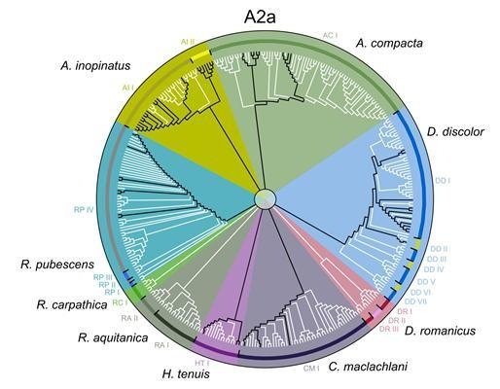
(3) Genetic Diversity
White branches show lost genetic lineages by 2080 if global temperature increases by four degrees
Miklos Bálint et al

